Slide 1



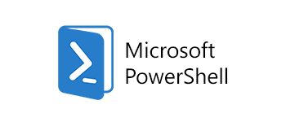
Automated DevOps Pipeline
php codesniffer
Apache
Ant
PHP Unit
DevOps KPI Measurement
Version Control Management
Build
Unit Testing
Code Analysis
Application Packaging
Jenkin As Integration
Engine
Continuous Integration and Delivery
Monitoring and Management
Promote to Staging / Prod
Functional, Performance & Regression Test
Deployment Scripting and Configuration
Infrastructure Automation
Bug Reporting
Jira
Selenium
ARM Templates
Insights
* Build, Bug & testing will be part of VSTS component.

Slide 2




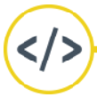


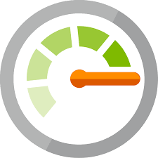


Automated DevOps Pipeline
Plan
Develop
Integrate
Deploy
Release
PHP
Code
Release
Version Control
Apache Ant
Test
Package repository
Jenkins integrated with Rally
Planning
Git Hub
Build
Pass
Developer
Unit Tests
PHP Unit
Static Analysis
Deploy and run Integration tests
Integration Tests
Deploy and run Regression tests
Code Review
Test Fail
S1
S2
DEV
QA
PROD
Code analysis
Bug Report
Azure Hosting Environments
Log Analysis & Monitoring
Operations
Incident
Production Incidents, problems will be logged into ServiceNow
2

Slide 3


Continuous Integration and Deployment with Visual Studio
Build Definition
Release Definition
Release to
QA, UAT
Release to
Production
Nuget Installer
Powershell – to
apply version to
build
Add Environment
Visual Studio Build
– Build Solution
DEFINITION STEPS
DEFINITION STEPS
Testing
Copy files to
Build directory
Azure web app
Deployment
Publish Build
Artifacts

Slide 4

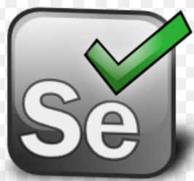




DevOps - Automation
Reference Architecture - Microservices
3
2
Jenkins Slave
4
Sonar Report
2
5
Jenkins Master
Artifacts
Jenkins Slave
6
Deployment
Service
Container
1
Git Repository
Logo Courtesy: Jenkins, Maven, SonarQube, Git, Nexus Repsoitory

